Slide 1
An s-shaped three-parameter (S3) traffic stream model with consistent car following relationship
Qixiu (Kevin) Cheng ª, Zhiyuan Liu ª, Yuqian Lin ª, Xuesong (Simon) Zhou ^{b}
ª School of Transportation, Southeast University, China
^{b} School of Sustainable Engineering and the Built Environment, Arizona State University, USA
^{2021.02.11}

Slide 2
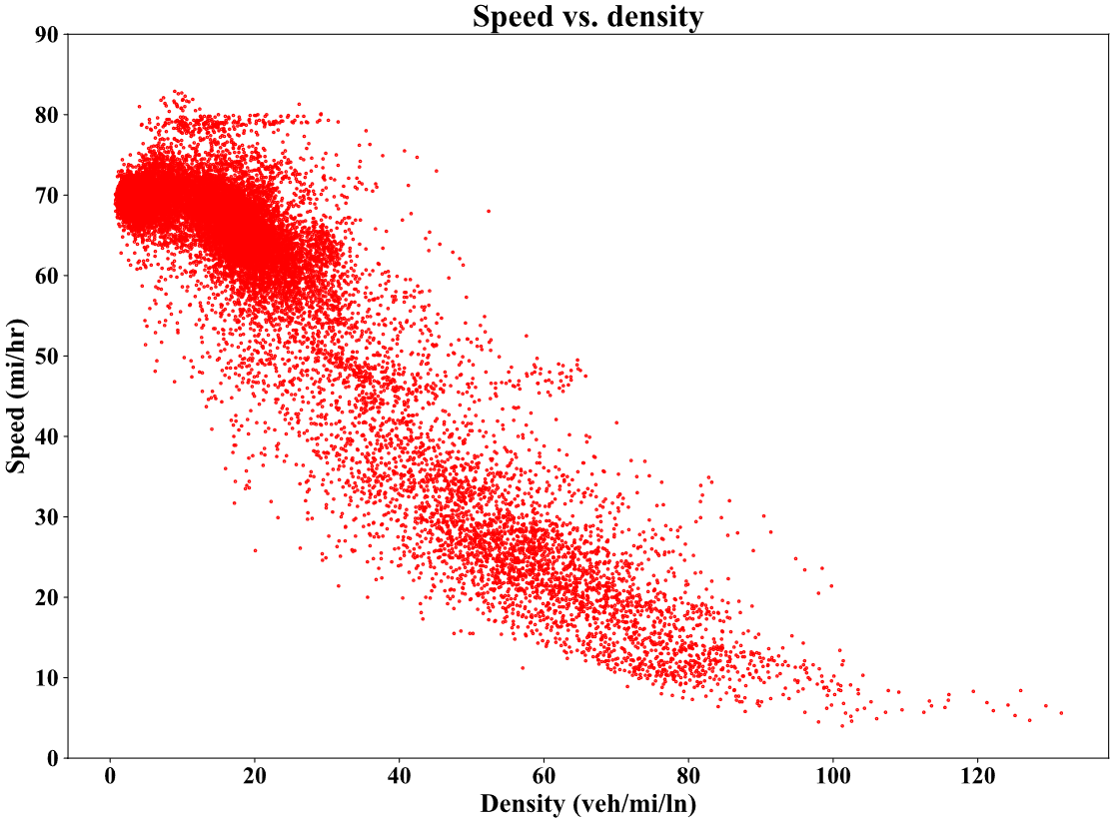
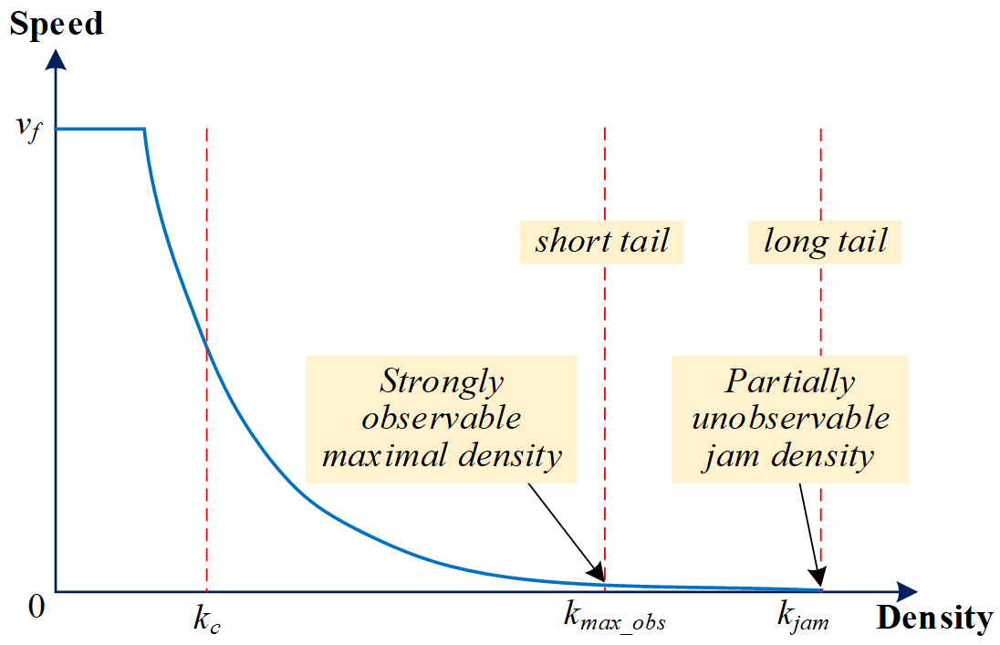
Observations on the Speed-density Relationships
Characteristics for a well-defined single-regime speed-density function:
the speed is a strictly and monotonically decreasing function with respect to density;
the speed keeps relatively stable at the free flow state (or in a low-density range);
the speed keeps relatively slow, but not reach zero, under heavily congested condition (or in a high-density range);
it can smoothly capture transition between different traffic states;
describe the speed-density relationships with as few parameters as possible; and
maintain important consistency across planes of flow-density, speed-flow based on the conservation condition of q=kv.

Slide 3
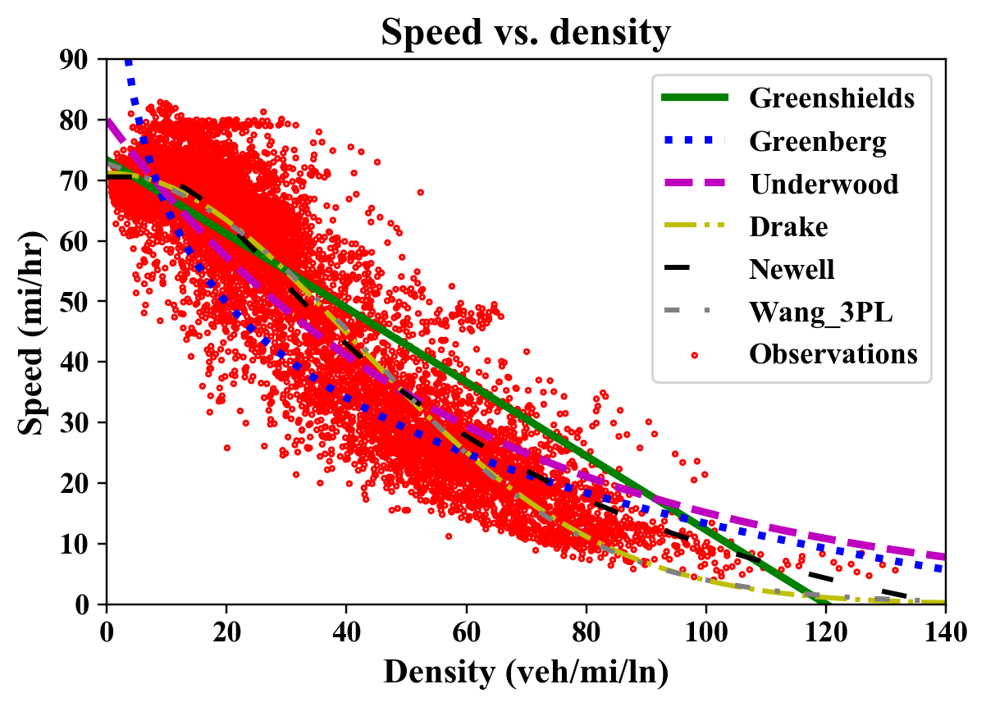
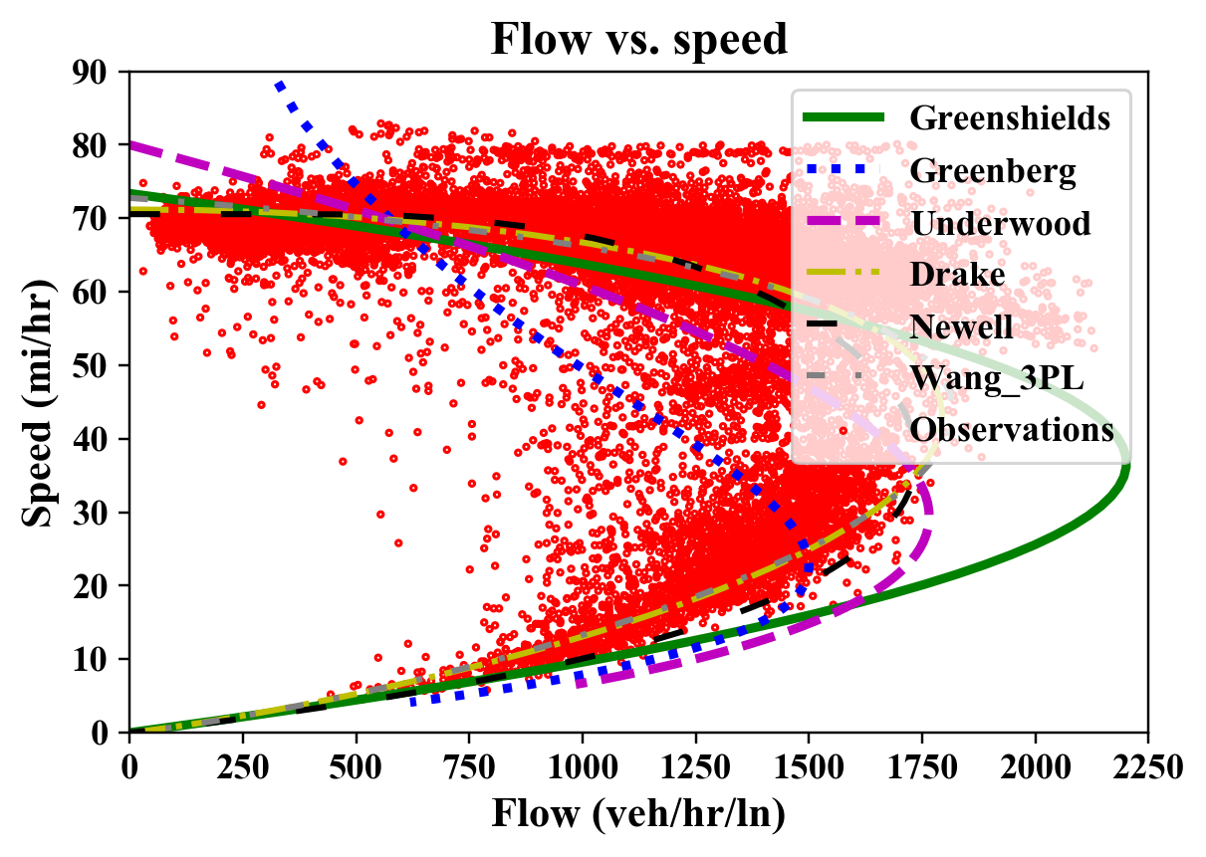
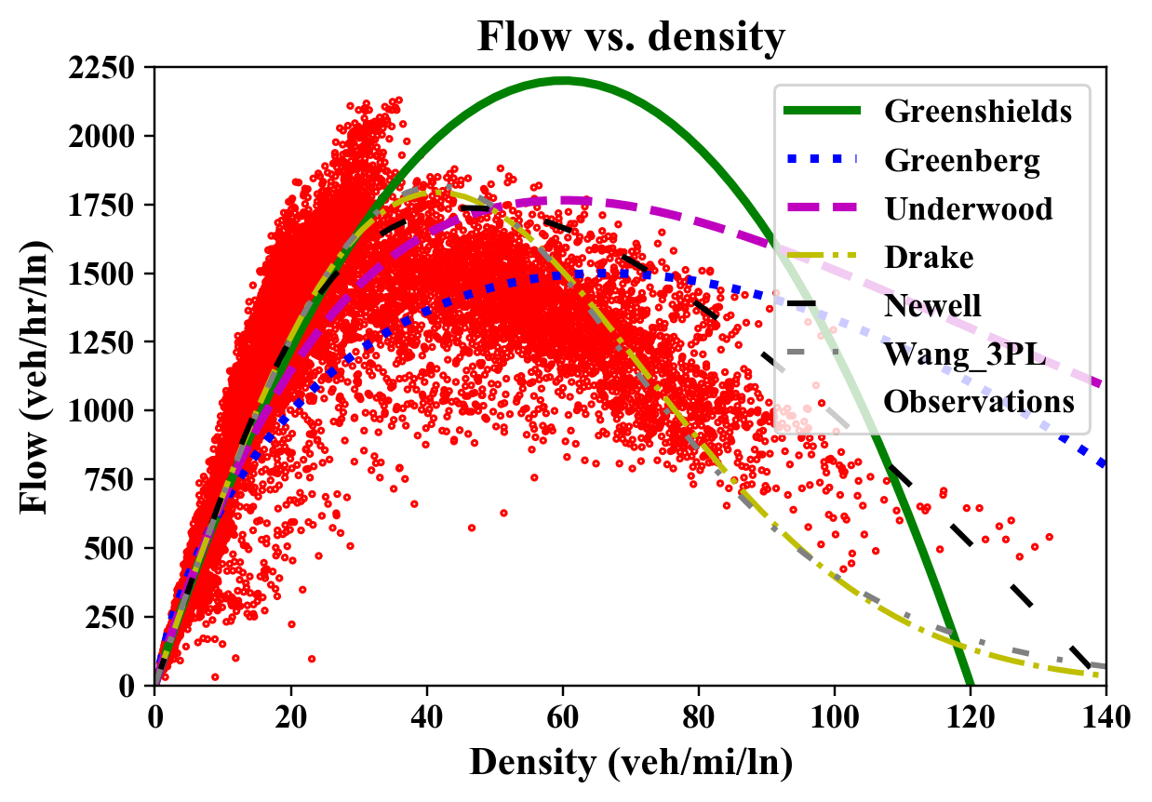
Speed-density Relationships in the Literature
inaccurate at high densities

Slide 4
S-shaped Three-parameter (S3) Fundamental Diagram
where $v_{f}$ is the free flow speed, $k_{c}$ is the critical density which can result in a maximal traffic flow rate, and $m$ and $l$ represent the flatness of the curve (FoC) to be determined.
q(k) is continuously differentiable. When k=k_{c}, we have q=q_{max}.

Slide 5
S-shaped Three-parameter (S3) Fundamental Diagram
Averaged maximal flow rate (or capacity):
Explanation of the FoC parameter m:
where $v_{c}$ is the speed at the critical density.

Slide 6
S-shaped Three-parameter (S3) Fundamental Diagram
Projections to the 2D planes:

Slide 7
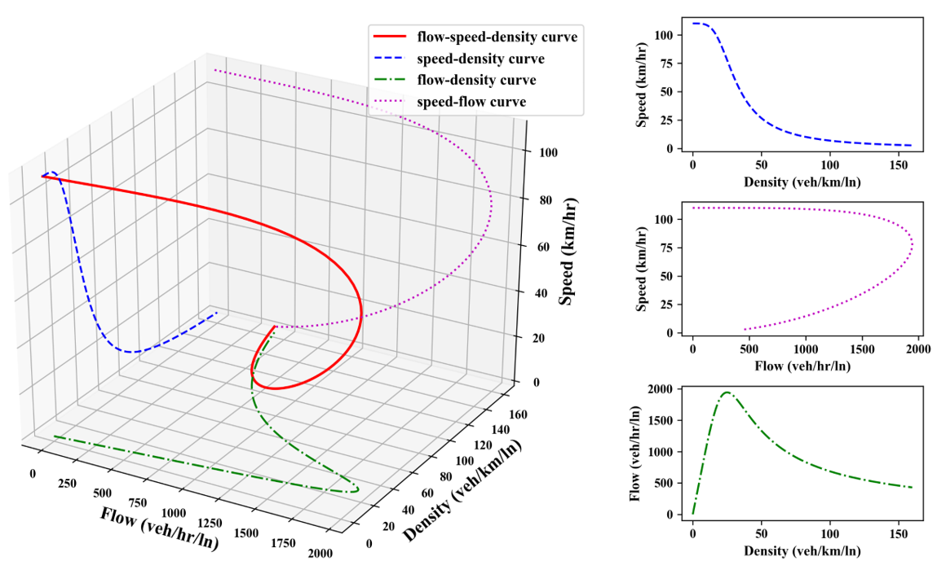
S-shaped Three-parameter (S3) Fundamental Diagram
3D Space when m=4

Slide 8
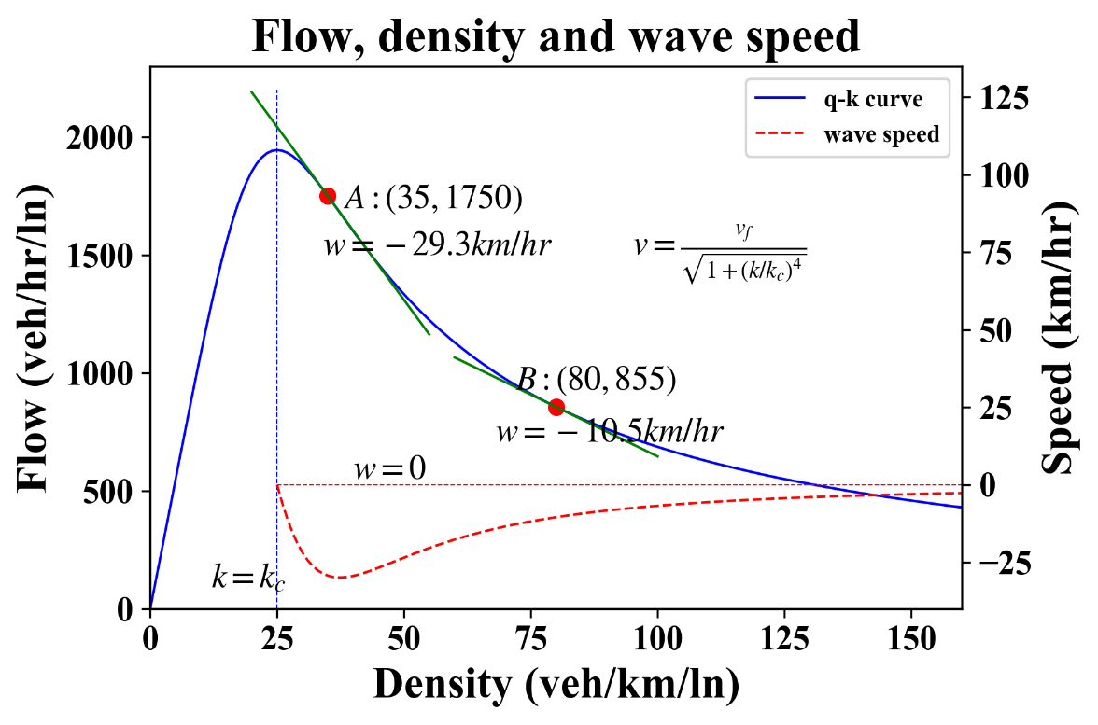
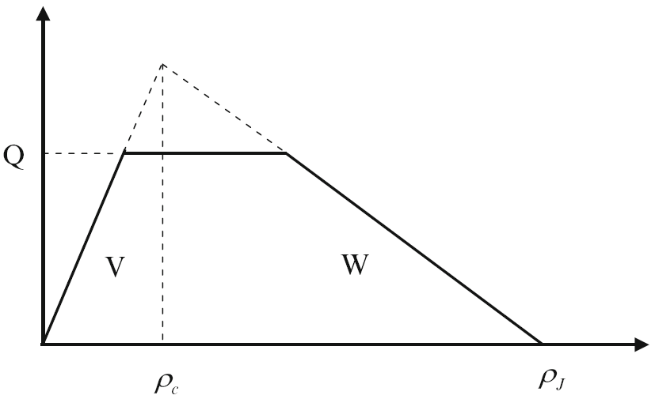
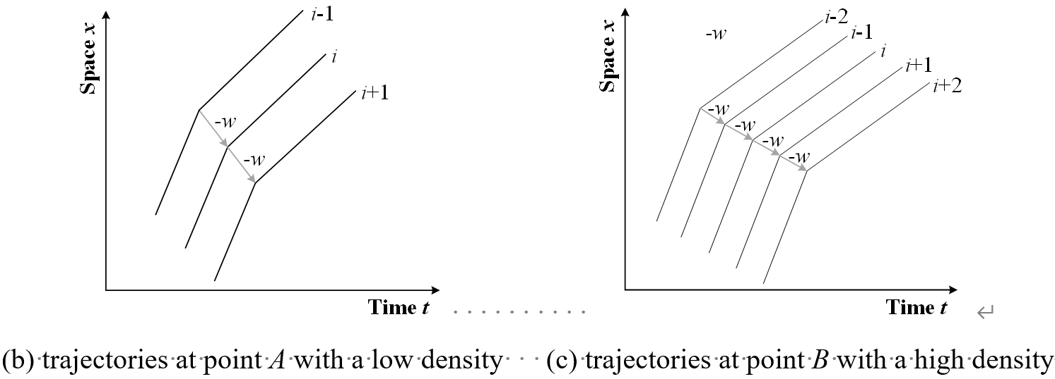
S-shaped Three-parameter (S3) Fundamental Diagram
Relationship to the backward wave speed
Triangle fundamental diagram used in CTM
From the perspective of simplified car following model, our model indicates that the reaction time could become longer if we assume a constant minimum spacing. However, this explanation should be further verified with real-world traffic data in the future.

Slide 9
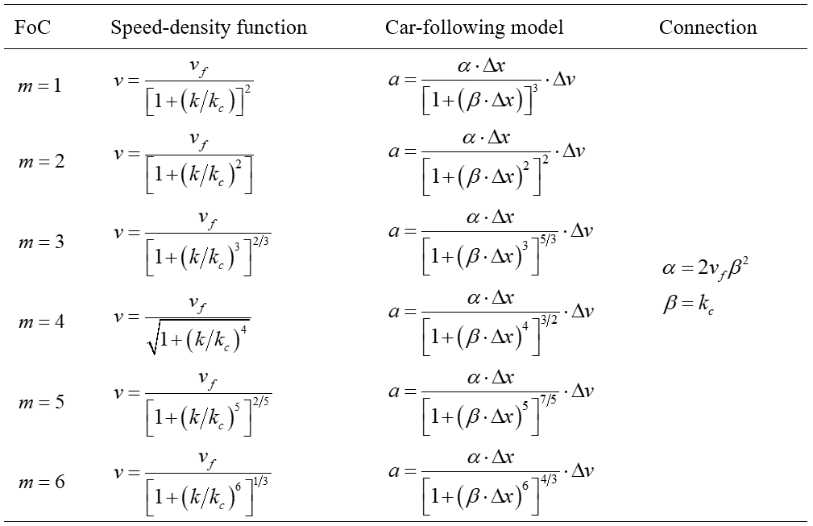
Deriving Macro-to-Micro Car-following Models
Macroscopic speed-density
Microscopic car-following

Slide 10
Stability Analysis on the Car-following models
Laplace transform based approach to analyze the stability
The proposed car-following model is stable if and only if the real parts of the solutions in the following equation are all negative.
where h is the headway space at stable state, s is the complex variable in the Laplace transform.
It should be noted that, although the above functional form seems to be relatively simple, solving it is nontrivial. Mathematically, the type of the above equation is called Lambert W function or omega function, and one can solve it numerically to obtain the stability criterion.

Slide 11
Calibration for the S3 model as a nonlinear regression
[M1]
[M2]

Slide 12
Calibration for the S3 model (study area)
The loop detector data is collected on July 1st (Monday), 2019 from Absolute Postmile (Abs) 1.79 to Abs 30 on the freeway of US101-S in Los Angeles, USA from the open-access PeMS database, including the speed, flow, and occupancy, etc.

Slide 13
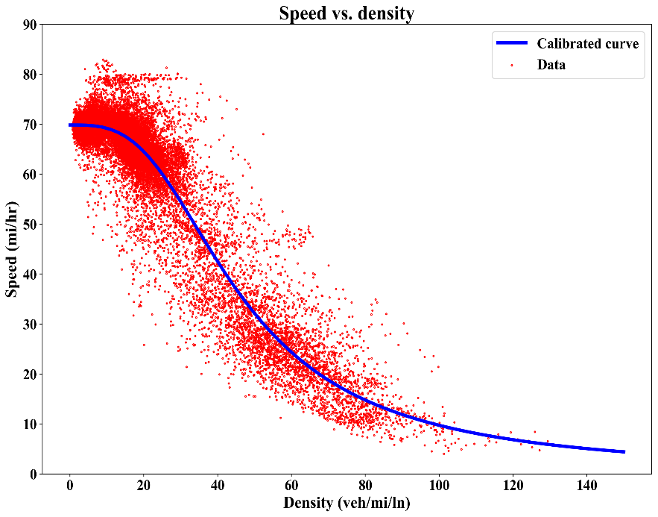
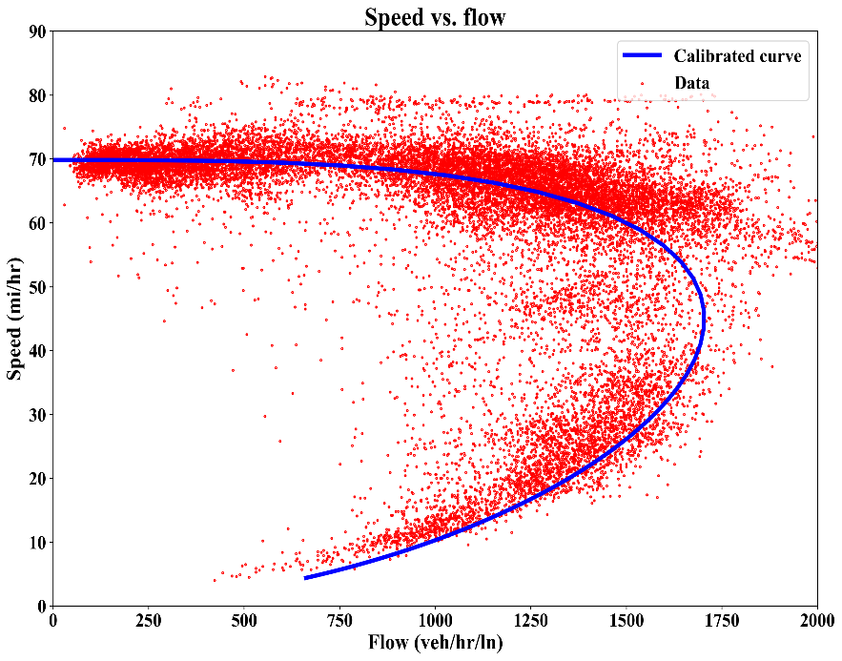
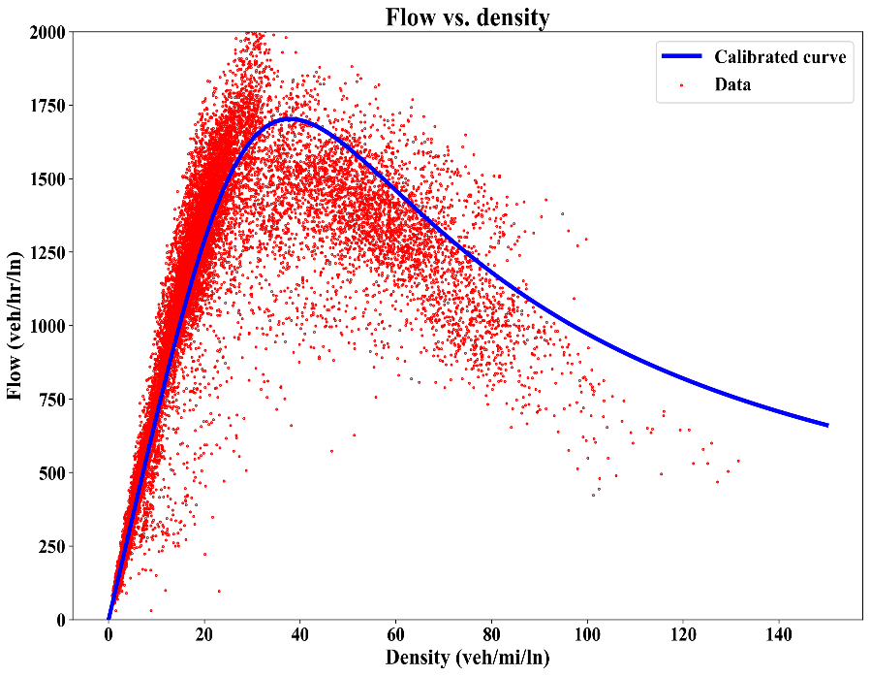
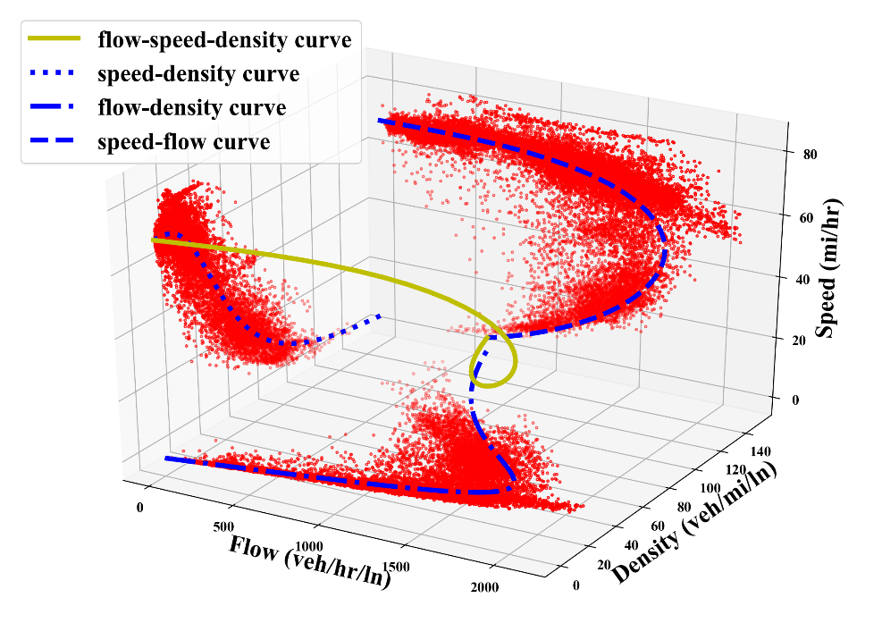
Calibration for the S3 model (Results_M1)
Notes:
PeMS

Slide 14

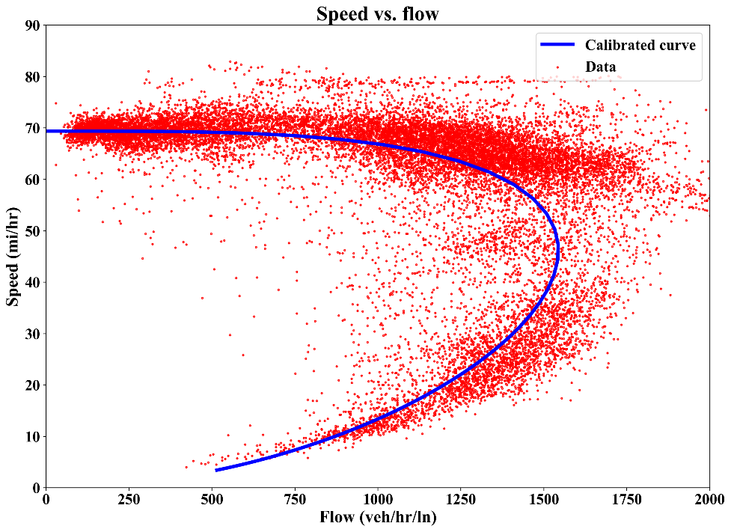
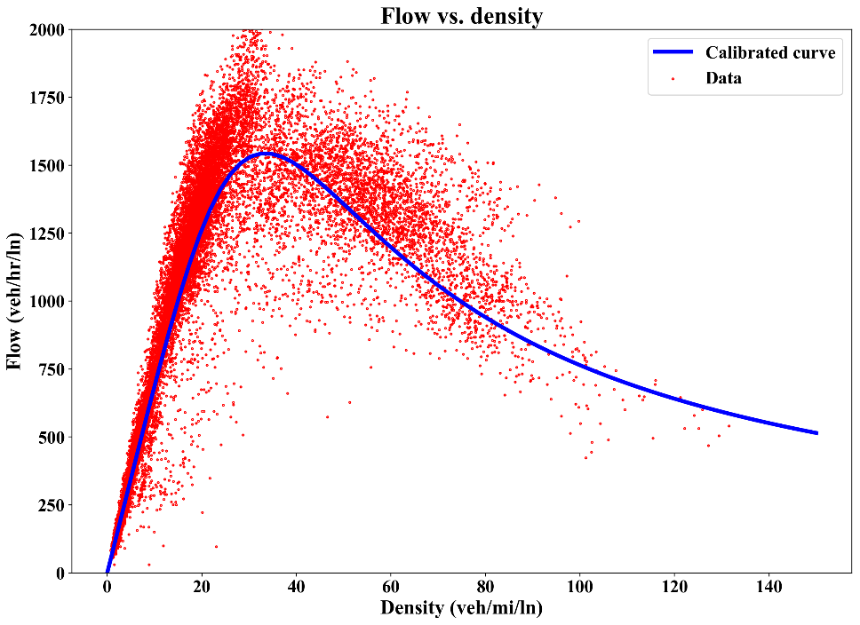

Calibration for the S3 model (Results_M2)

Slide 15
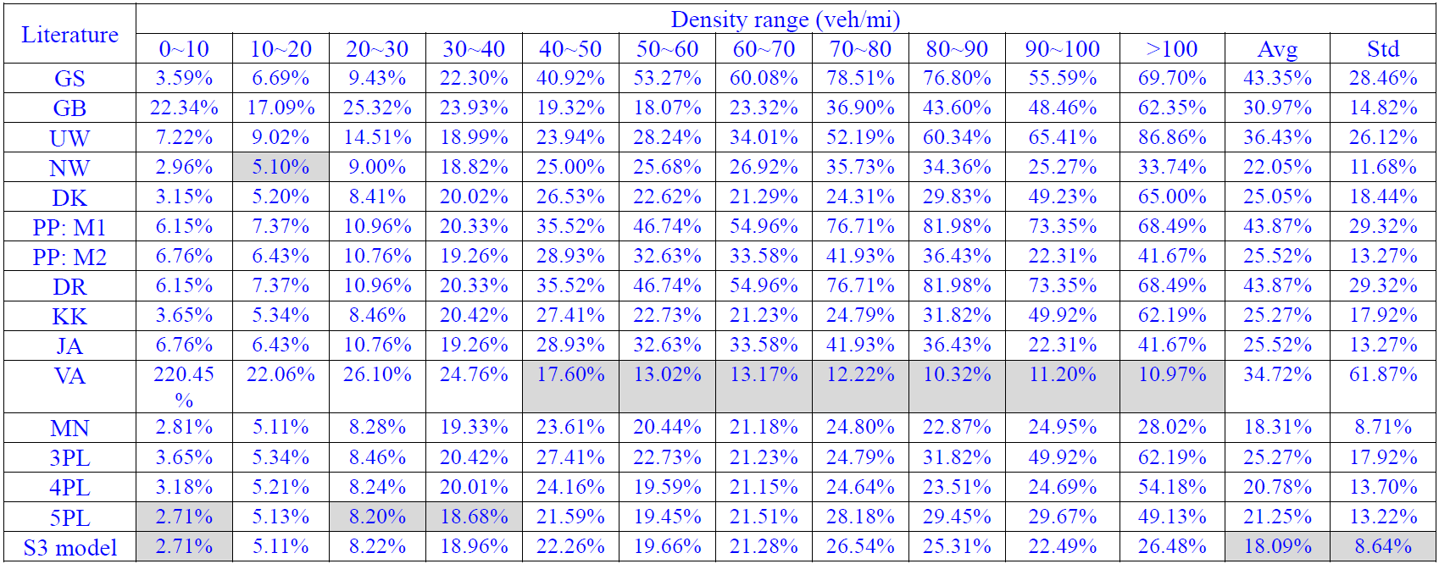
Calibration for the S3 model (Comparison)
Comparison of MRE on the estimated speed with only speed information in the objective function

Slide 16
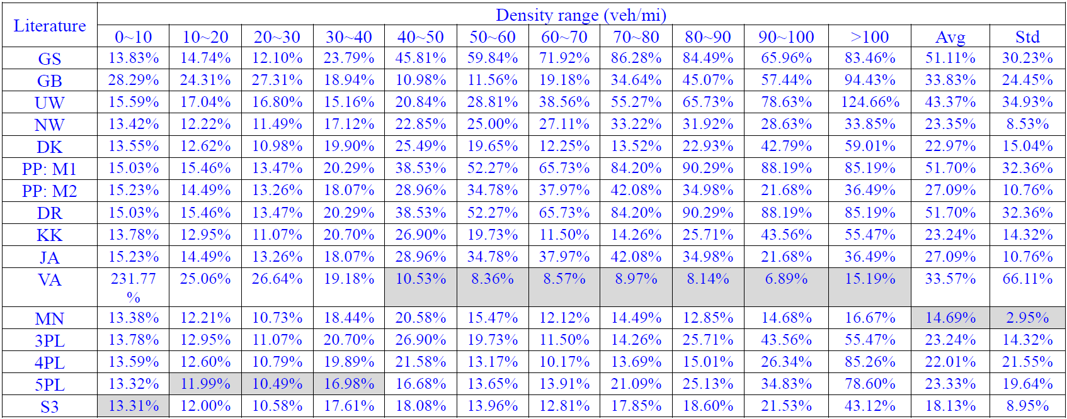
Calibration for the S3 model (Comparison)
Comparison of MRE on the estimated flow with only speed information in the objective function

Slide 17
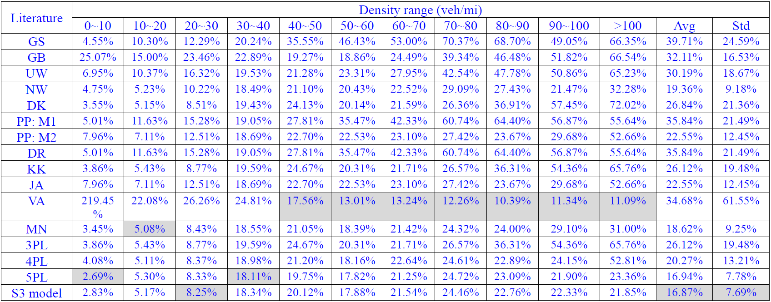
Calibration for the S3 model (Comparison)
Comparison of MRE on the estimated speed with both speed and flow information in the objective function

Slide 18
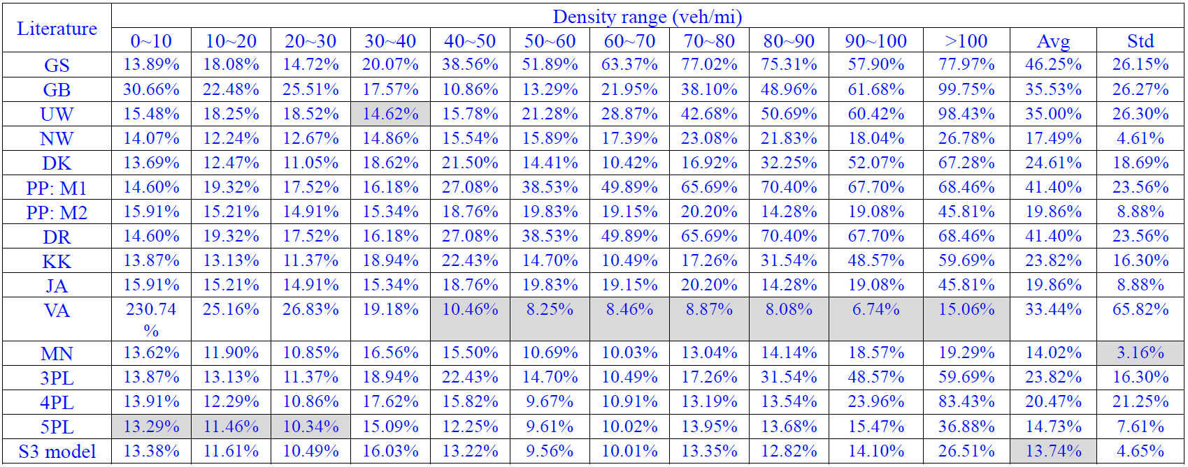
Calibration for the S3 model (Comparison)
Comparison of MRE on the estimated flow with both speed and flow information in the objective function

Slide 19
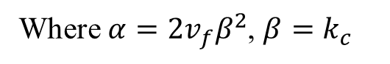
Calibration for the Car-following Model
Where $α=2v_{f}β^{2}$, $β=k_{c}$

Slide 20
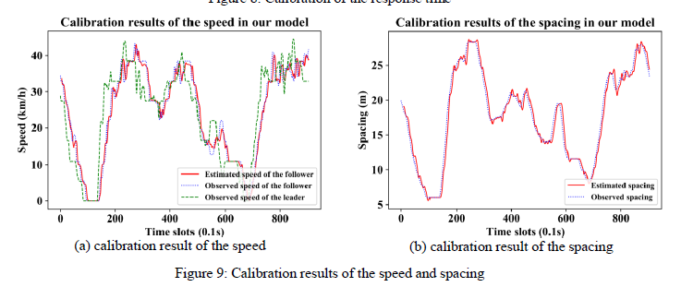
Calibration for the Car-following Model
Notes:
NGSIM

Slide 21
Conclusion
With a particular emphasis on the inaccurate estimation issue of the existing speed-density models especially at high density ranges, this paper is motivated by the need to establish an empirically accurate and mathematically elegant speed-density relationship which can describe the speed-density relationship under all possible traffic states.
It has been evident that over the past decades, continuing advances in the traffic flow fundamental diagram intrinsically depend on the two-dimensional representation to describe the speed-density relationship, while other relationships between speed and flow or flow and density are ignored. This paper proposes an enhanced “s-shape” speed-density function. One can easily represent the traffic flow fundamental diagram in a three-dimensional modeling space.
With the macroscopic S3 model, a consistent macro-to-micro car-following model is derived. By utilizing the Laplace transform approach, the stability criterion of the car-following model is also derived.
The study presented in this paper is an example to represent the traffic flow fundamental diagram with a smooth and non-convex-non-concave s-shaped curve. In the future, it is possible to analyze the state transitions due to the existence of inflection point in the non-convex-non-concave curve. As for the calibration of the S3 model, it is expected to calibrate the parameters considering heterogeneity on the vehicle types and road grades in future work.
Notes:
NGSIM

Slide 22
Future Applications
Analyze the traffic state transitions with smooth analytical forms
Provide analytical formulas for the MFD to better control traffic flows in urban networks
Higher order traffic flow models
Calibrate traffic flow model at merge and weaving segments since the capacity, free-flow speed, critical density, and the car-following model can be synthetically calibrated
Notes:
NGSIM

Slide 23
Thank you!
Notes:
NGSIM

